Slide 1
Green Energy System Performance Evaluation and Prediction Using Machine Learning
Advisor: Professor Gao
By: Leo Guo, Janaarthana Harri Palanisamy, Gabrielle Viray

Slide 2
Background and Motivation

Slide 3
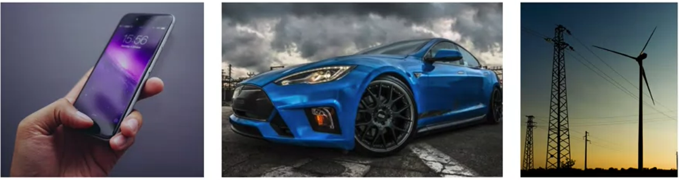
Motivation
Batteries power our modern lives
Notes:
Jana

Slide 4
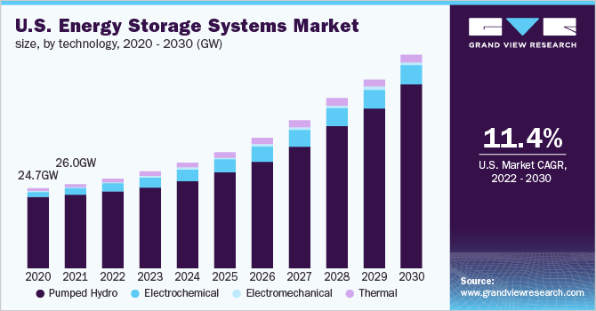
Energy Storage System Market
Valued 211.24 GW in 2021 and is progressing at a compound annual growth rate (CAGR) of 11.0% from 2022 to 2030.
Valued at $188.5 billion in 2020, and is projected to reach $435.4 billion by 2030, growing at a CAGR of 8.3% from 2021 to 2030.
Asia-Pacific, followed by Europe and North America, to maintain its dominance by 2030.
Notes:
Jana

Slide 5
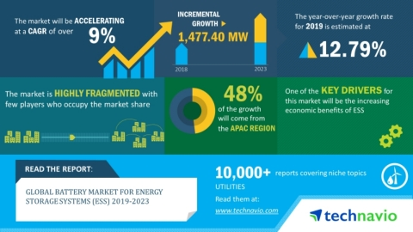
Battery Market for Energy Storage Systems
Battery Market is poised to grow by 1477.40 MW in terms of units during 2019-2023, progressing at a CAGR of over 9% during the forecast period.
Notes:
Jana

Slide 6
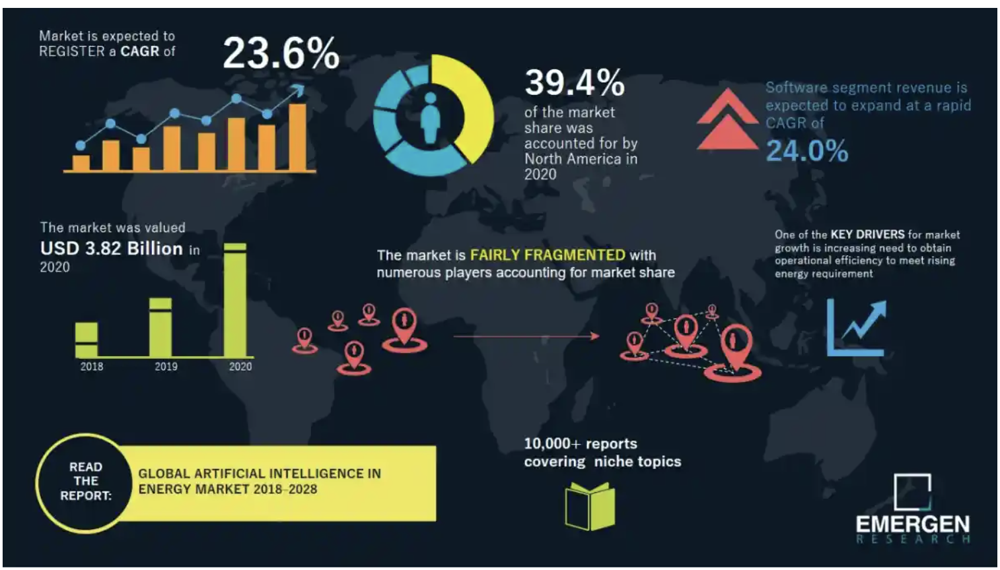
AI in Energy Market
The growing importance of battery technology, energy storage deployments enjoyed 93% growth year-over-year up to the start of Covid-19. And the market is expected to enjoy an 8-fold increase in value from 2020 to 2024.
Stanford scientists combine AI and atomic-scale images in pursuit of better batteries.
Notes:
Jana

Slide 7
Project Background
Batteries must be properly managed by electronics, software:
  Protect the application user
  Protect the battery pack itself
  Maximise the performance (power and energy) delivered by the battery
Three important features of the battery
  State of Charge (SoC)
  State of Health (SoH)
  Remaining Useful Life (RUL)
Notes:
Gabrielle

Slide 8
Project Agenda and Structure

Slide 9
Project Deliverables
State-of-art analysis
Data collection and cleaning
Data visualization
Machine learning models
Model Evaluation and Testing
Web System - Cloud Service
  AWS S3 to store the uploaded data for analysis and estimation.
  AWS EFS to upload Machine learning models in the file system.
  AWS Lambda to trigger the ML model code.
  AWS SAM for deployment.
Notes:
Gabrielle

Slide 10
Project Requirements
A web system for in-depth analysis and feature prediction for battery datasets.
Various pre-trained machine learning models for predicting the features.
Can choose a pre-loaded dataset from the web system or upload their own battery data.
Can choose a machine-learning model to train the dataset.
Can choose a feature for the model to predict using the chosen dataset.
Can Predict SoC, SoH, RUL.
APIs to fetch the required outputs from the machine learning models to the web view.
A dashboard that displays the result for the chosen model and feature prediction.
A table that displays a comparison table for different models for a feature.
Notes:
Gabrielle

Slide 11
Team Organization and Function Roles
Team Member | Responsibilities | Implementation
Leo Guo | Investigated various battery datasets and researched technology survey Built a dataset table with description | Regression and Classification Model for Life Cycle prediction Back-end Front-end
Janaarthana Harri Palanisamy | Examined market research and helped with literature review search | Neural Network Regression and Classification Model for Life Cycle Prediction Front-end
Gabrielle Viray | Researched several papers for different battery problems for literature review | Regression and Classification Model Model for Life Cycle Prediction Front-end
Notes:
Gabrielle

Slide 12
Surveys

Slide 13
Literature Survey: State-of-Health (SoH)
Paper ID | Purpose | Datasets Used | Battery Type | Models | Evaluation Metrics
 |  |  |  |  | RMSE | MAE | MAPE | R2 | Accuracy
[1] | SoH Prediction | NCM data LFO data from CALCE LEP data from MIT-Stanford | Nickel cobalt Manganese Lithium cobalt oxide Lithium iron phosphate | LSTM with Transfer Learning | 0.42 | 0.31 | N/A | N/A | N/A
[2] | Monitoring SoH (With Savgol Filter) | LPF/graphite cells data from A123 Systems | Commercial Lithium iron phosphate | Linear Reg. PLS Reg. MLP Random Forest | 1.07 1.54 1.96 1.53 | N/A | N/A | 0.93 0.85 0.68 0.83 | N/A
[3] | SoH Estimation | NASA (Battery #5) | Lithium-ion | LSTM BiLSTM | 0.0249 0.0099 | 0.0156 0.0091 | 0.0359 0.0072 | N/A | N/A
[4] | Long Horizon SoH Prediction | NASA and Oxford | Lithium-ion | NARXRNN (Cycle 100) | 0.0157 | 0.0116 | N/A | N/A | N/A
[5] | SoH Evaluation | MIT-Stanford CALCE VPSL | Lithium iron phosphate Lithium cobalt oxide Nickel cobalt Manganese | Linear Reg. SVM RVM GPR | 0.0179 0.0132 0.0155 0.0127 | 0.0139 0.0102 0.0119 0.0098 | N/A | N/A | N/A
[6] | SoH time series prediction | Dataset of 45 lithium-ion battery packs | Lithium-ion | Gradient Boosting | 0.26 | 0.18 | N/A | 1.0 | N/A
Notes:
Gabrielle

Slide 14
Literature Survey: State-of-Charge (SoC)
Paper ID | Purpose | Datasets Used | Battery Type | Models | Evaluation Metrics
 |  |  |  |  | RMSE | MAE | MAPE | R2
[7] | SoC Estimation | EV dataset with ambient temp increasing from 10 to 25 *C | Lithium-ion battery packs | LSTM-RNN (25 *C) | 0.007 | 0.006 | N/A | N/A
[8] | SoC Estimation | Panasonic NCR18650PF cell data | Nickle-cobalt-aluminum oxide | Physics Constrained NN | 0.0036 | 0.0083 | N/A | N/A
[9] | SoC Estimation based on Voltage | HV Packs Tester by Digatron | Lithium-ion batteries connected in parallel | MEA-BP Algo. Charging Discharging (0.2 *C) | N/A | N/A | 0.0051 0.0063 | N/A
[10] | SoC Estimation | Arbin BT2000 Tester – Battery Testing System | BAK 18650 battery | GRU CNN-GRU | 0.0177 0.0167 | 0.0147 0.0133 | N/A | N/A
[11] | SoC Estimation | 18650 datasets from UMD | 18650 batteries | ED DA-LSTM DA-GRU | 1.3913 0.4918 0.3869 | 1.0671 0.3677 0.3209 | N/A | 0.9972 0.9996 0.9998
Notes:
Gabrielle

Slide 15
Literature Survey: Remaining Useful Life (RUL)
Paper ID | Purpose | Datasets Used | Battery Type | Models | Evaluation Metrics
 |  |  |  |  | RMSE | MAE | MAPE | R2 | Accuracy
[12] | Lifetime Forecasting | Aging dataset 40 NMC cells | Nickel Cobalt Manganese | GPR | 0.0159 | 0.0151 | N/A | N/A | N/A
[13] | Battery Monitoring System - RUL | Battery Packs connected in series relation | Lithium-ion | LSTM | 0.058 | N/A | N/A | N/A | N/A
[14] | RUL Prediction | NASA | Lithium-ion | ADNN Bayesian Reg. Linear Reg. SVM | 0.0666 0.1192 0.1200 0.1066 | N/A | N/A | N/A | 0.9334 0.8908 0.8800 0.8934
[15] | Early Lifetime Prediction | MIT dataset (first 100 cycle degradation data) | Lithium-ion | GPR SVM RF | (Cycles) 119 115 152 | N/A | 0.089 0.080 0.117 | 0.89 0.90 0.83 | N/A
Notes:
Gabrielle

Slide 16
Technology Survey
Company | Product Name | Purpose | Usage | Cloud | AI | Functions
STEM | - | Deliver successful energy storage solutions | BMS | - | Y | System Design & Engineering Warranty & Preventative Maintenance Plan Management Supply Chain Management & Procurement O&M Reporting Energy Storage Value Stream Optimization Program Enrollment & Incentive Management
ENERGSOFT | Medium Size B2B Battery Analytics Software | Offers a unified data analytics software platform. | BMS | Y | Y | Improves battery value and profitability
Entro Technology | BMSTAR | Hardware agnostic software platform | BMS | Y | Y | Predictive Cell Diagnosis
Oxford University | ABLE | Python software for estimating the state of health of batteries from measured current, voltage, and temperature data | Health of battery | - | Y | Predict SOH. Classify battery healthy or faulty
AGREATE | ATEN | Commercial renewable energy battery packs | BESS | - | Y | Predict failure or need to change batteries.
Fuergy | brAIn, mosAIc | Smart battery storage solution | BMS | - | Y | Lower utility bills Improved green energy production power outage protection energy self-sufficient
Notes:
Leo

Slide 17
Data
Notes:
Leo

Slide 18
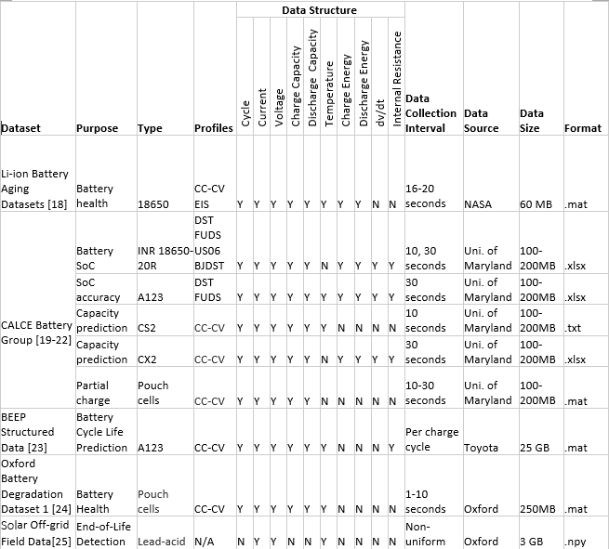
Data Summary
Common Features
Various Battery Types
Multiple Purposes

Slide 19
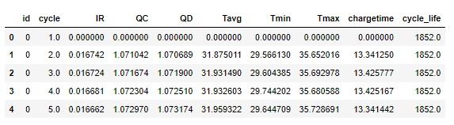
Data Preparation
Purpose: Extract information from data
Check missing value
Data transformation for machine learning models
Annotation for classification
Notes:
Leo

Slide 20
Data Preparation for NN
Purpose: Standardize input format for all battery types
Data cleaning
Create new features such as battery type
Check input dimension
Create label for classification model
Notes:
Leo

Slide 21
Model

Slide 22
Battery Degradation Prediction (CALCE Dataset)
Used publicly available charge/discharge data from Center for Advanced Life Cycle Engineering (CALCE) at the University of Maryland.
Obtained data from 4 different CS2 cells which were cycled under constant current and constant voltage.
It was divided into multiple data and the number of cycles were also random, formatted and preprocessed the data appropriately.

Slide 23
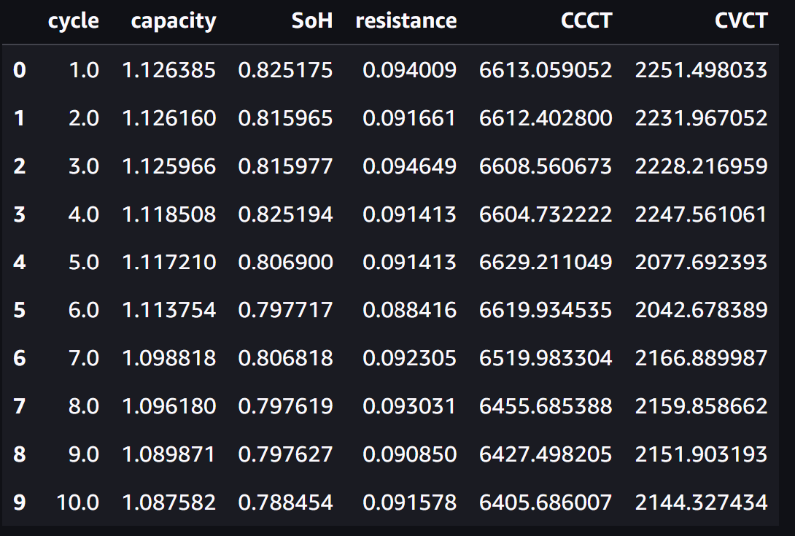
Dataset after preprocessing

Slide 24
Models and Results
 | MLP | RNN | LSTM
MAE | 0.1557 | 0.0938 | 0.0582
RMSE | 0.2038 | 0.1009 | 0.736

Slide 25
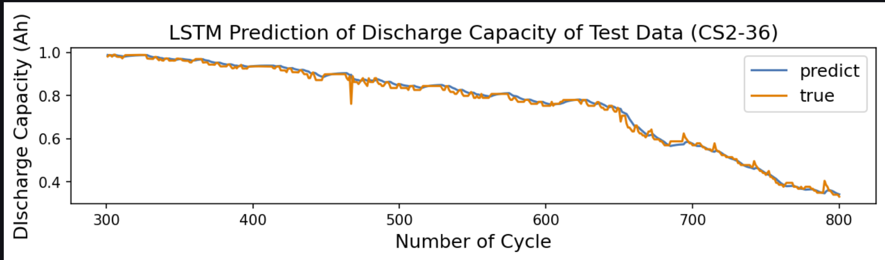

Slide 26
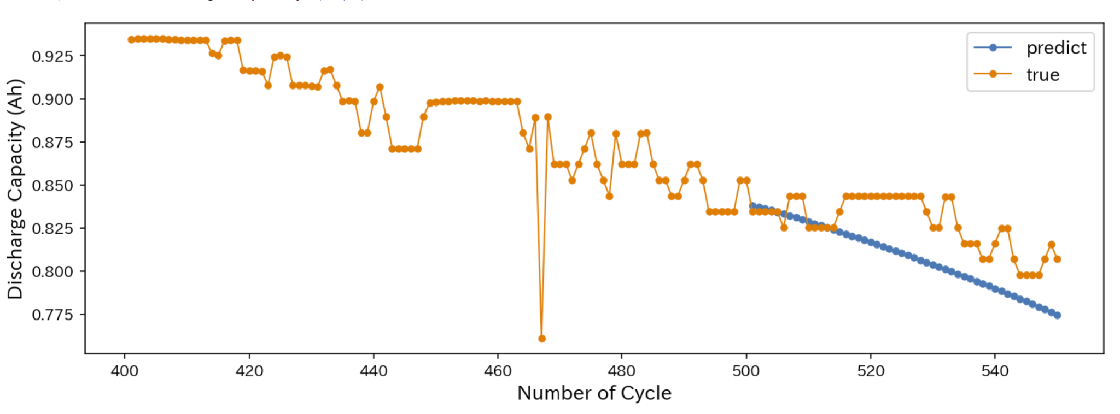
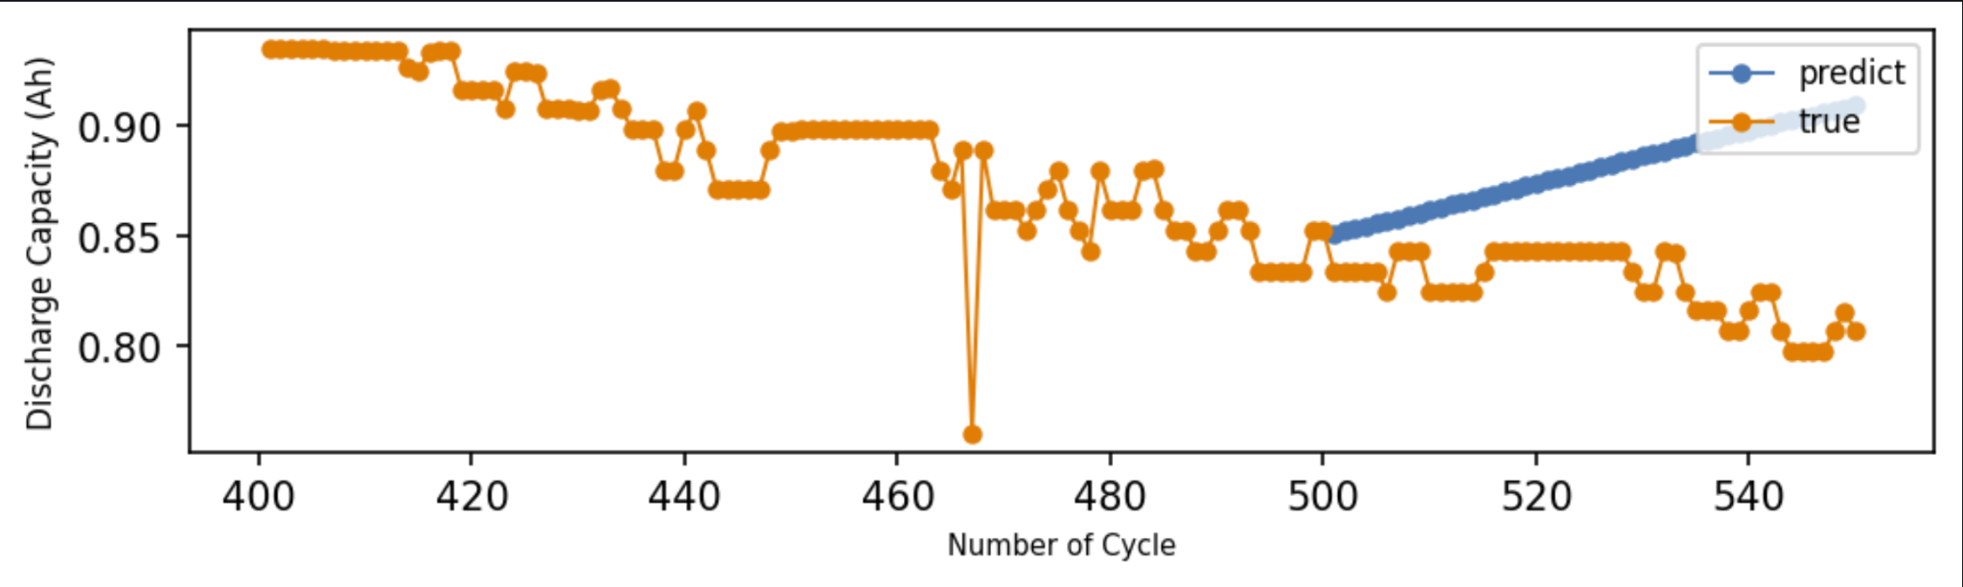

Slide 27
Life Cycle Prediction
Predict overall life cycle in early stage
Model
  Linear Regression
  Random Forest (Regression and Classification)
  Neural Network (Regression and Classification)
Notes:
Leo

Slide 28
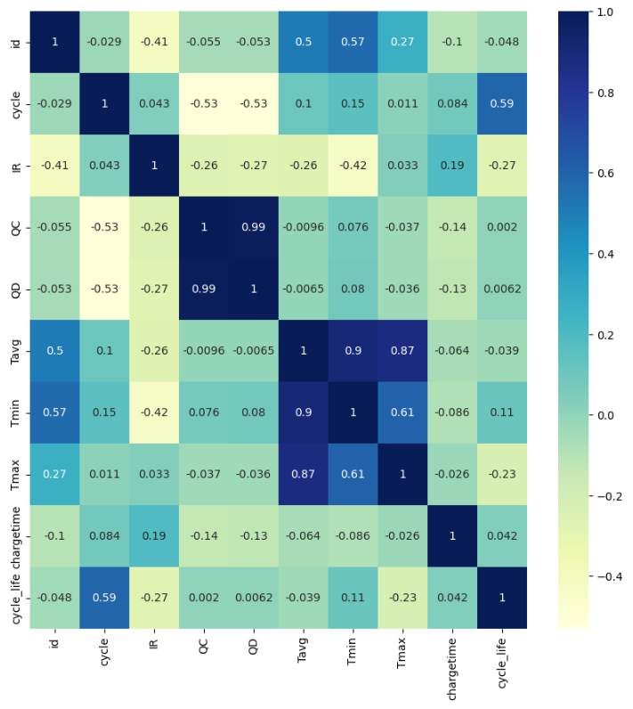
Regression
Selected data from cycle 10-100
Predict the total life cycle of each battery
Explore Correlation
Minimize the error of result

Slide 29
Result
Model | Train Error | Validation Error | Reference Value
Linear Regression | 268 | 274 | 119
Random Forest | 84 | 87 | 151
Neural Network | 152 | 153 | 206

Slide 30
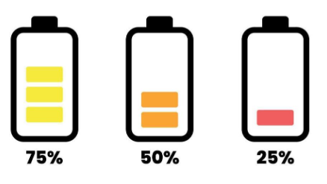
Classification
Derive battery condition from life cycle -> percent of life cycle
Determine battery health condition with 3 categories
Threshold:
  >=70% (Healthy)
  >30% <70% (Good)
  <=30% (Bad)

Slide 31
Life Cycle Prediction Model
Classification Model | Training accuracy | Validation accuracy
Random Forest | 94% | 93%
Neural network | 92% | 91%
Notes:
Leo

Slide 32
System Design

Slide 33


Frontend
React
Node.js

Slide 34
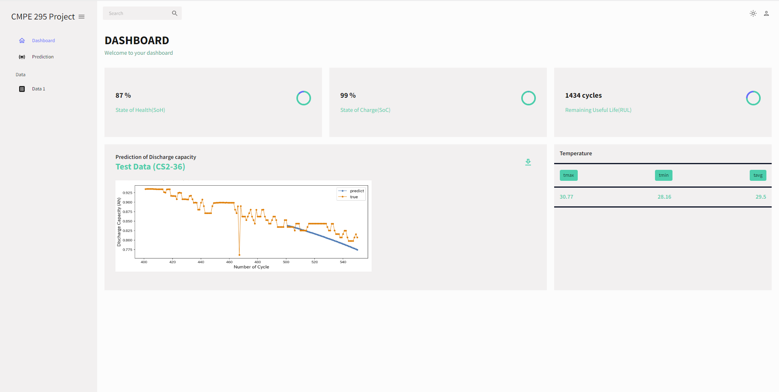
Dashboard UI

Slide 35
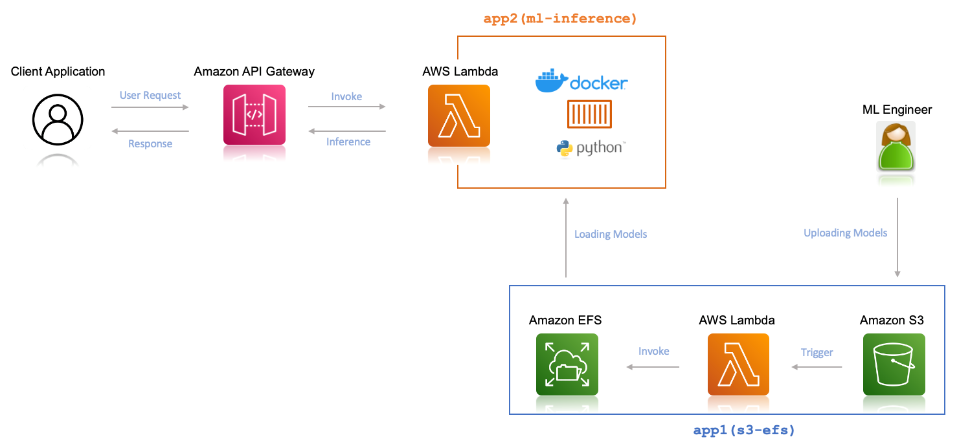
Backend Infrastructure

Slide 36
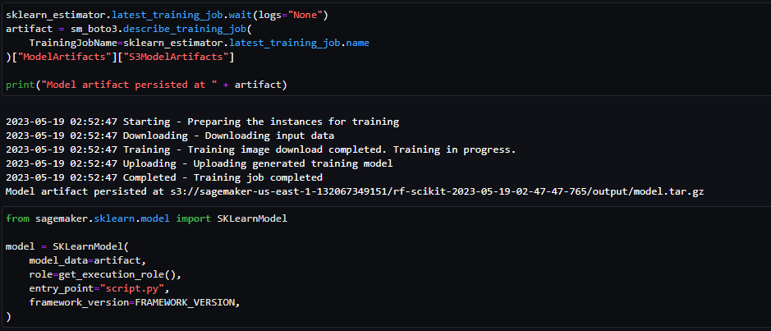
Sagemaker
Model Training
Tuning
Deployment

Slide 37
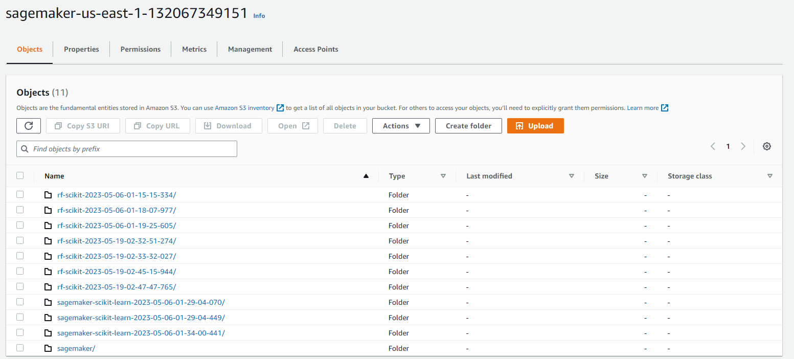
Sagemaker

Slide 38
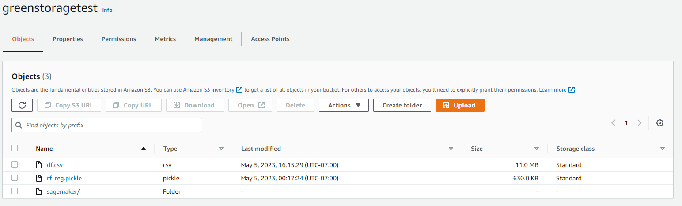
S3

Slide 39
Conclusion

Slide 40
Conclusion
Improved error and accuracy of models
Precise prediction of battery life cycle, and health condition
Monitoring of battery condition

Slide 41
Future work
Real world data to improve data pipeline
Accept more types of data format
Research in battery charging and discharging control

Slide 42
References
X. Shu, J. Shen, G. Li, Y. Zhang, Z. Chen and Y. Liu, "A Flexible State-of-Health Prediction Scheme for Lithium-Ion Battery Packs With Long Short-Term Memory Network and Transfer Learning," in IEEE Transactions on Transportation Electrification, vol. 7, no. 4, pp. 2238-2248, Dec. 2021, doi: 10.1109/TTE.2021.3074638.
A. Varshney, A. Singh, A. A. Pradeep, A. Joseph and G. P, "Monitoring State of Health and State of Charge of Lithium-Ion Batteries Using Machine Learning Techniques," 2021 IEEE 5th International Conference on Condition Assessment Techniques in Electrical Systems (CATCON), 2021, pp. 022-027, doi: 10.1109/CATCON52335.2021.9670522.
N. Khan, F. U. M. Ullah, Afnan, A. Ullah, M. Y. Lee and S. W. Baik, "Batteries State of Health Estimation via Efficient Neural Networks With Multiple Channel Charging Profiles," in IEEE Access, vol. 9, pp. 7797-7813, 2021, doi: 10.1109/ACCESS.2020.3047732.
S. Bamati and H. Chaoui, "Lithium-Ion Batteries Long Horizon Health Prognostic Using Machine Learning," in IEEE Transactions on Energy Conversion, vol. 37, no. 2, pp. 1176-1186, June 2022, doi: 10.1109/TEC.2021.3111525.
Z. Deng, X. Hu, X. Lin, L. Xu, Y. Che and L. Hu, "General Discharge Voltage Information Enabled Health Evaluation for Lithium-Ion Batteries," in IEEE/ASME Transactions on Mechatronics, vol. 26, no. 3, pp. 1295-1306, June 2021, doi: 10.1109/TMECH.2020.3040010.
M. Huotari, S. Arora, Avleen Malhi and K. Framling, “Comparing seven methods of state-of-health time series prediction for lithium-ion battery packs of forklifts, ” Journal of Applied Soft Computing, 2021, vol. 111, pp. 107670, doi: https://doi.org/10.1016/j.asoc.2021.107670.
E. Chemali, P. J. Kollmeyer, M. Preindl, R. Ahmed and A. Emadi, "Long Short-Term Memory Networks for Accurate State-of-Charge Estimation of Li-ion Batteries," in IEEE Transactions on Industrial Electronics, vol. 65, no. 8, pp. 6730-6739, Aug. 2018, doi: 10.1109/TIE.2017.2787586.
Z. Ni and Y. Yang, "A Combined Data-Model Method for State-of-Charge Estimation of Lithium-Ion Batteries," in IEEE Transactions on Instrumentation and Measurement, vol. 71, pp. 1-11, 2022, Art no. 2503611, doi: 10.1109/TIM.2021.3137550.
B. Zhao et al., "Estimation of the SOC of Energy-Storage Lithium Batteries Based on the Voltage Increment," in IEEE Access, vol. 8, pp. 198706-198713, 2020, doi: 10.1109/ACCESS.2020.3031327.
Z. Huang, F. Yang, F. Xu, X. Song and K. -L. Tsui, "Convolutional Gated Recurrent Unit–Recurrent Neural Network for State-of-Charge Estimation of Lithium-Ion Batteries," in IEEE Access, vol. 7, pp. 93139-93149, 2019, doi: 10.1109/ACCESS.2019.2928037.
K. Yang, Y. Tang, S. Zhang, and Z. Zhang, “A deep learning approach to state of charge estimation of lithium-ion batteries based on dual-stage attention mechanism, ” Journal of Energy, vol. 244, pp. 123233, 2022, doi: https://doi.org/10.1016/j.energy.2022.123233.
M. Hosen et al., “Battery cycle life study through relaxation and forecasting the lifetime via machine learning, ” Journal of Energy Storage, vol. 40, pp. 102726, 2021, doi: https://doi.org/10.1016/j.est.2021.102726.
J. K. Thomas et al., “Battery monitoring system using machine learning, ” Journal of Energy Storage”, vol. 40, pp. 102741, 2021, doi: https://doi.org/10.1016/j.est.2021.102741.
L. Ren, L. Zhao, S. Hong, S. Zhao, H. Wang and L. Zhang, "Remaining Useful Life Prediction for Lithium-Ion Battery: A Deep Learning Approach," in IEEE Access, vol. 6, pp. 50587-50598, 2018, doi: 10.1109/ACCESS.2018.2858856.
Z. Fei et al., “Early prediction of battery lifetime via a machine learning based framework, “ Journal of Energy Storage, vol. 40, pp. 120205, 2021, doi: https://doi.org/10.1016/j.est.2021.120205.
C. Vidal, P. Malysz, P. Kollmeyer and A. Emadi, "Machine Learning Applied to Electrified Vehicle Battery State of Charge and State of Health Estimation: State-of-the-Art," in IEEE Access, vol. 8, pp. 52796-52814, 2020, doi: 10.1109/ACCESS.2020.2980961.
R. R. Ardeshiri, B. Balagopal, A. Alsabbagh, C. Ma and M. -Y. Chow, "Machine Learning Approaches in Battery Management Systems: State of the Art: Remaining useful life and fault detection," 2020 2nd IEEE International Conference on Industrial Electronics for Sustainable Energy Systems (IESES), 2020, pp. 61-66, doi: 10.1109/IESES45645.2020.9210642.
Notes:
Leo

Slide 43
Thank you
Questions?
Notes:
Leo

